Slide 1


Department of Computer Science and Engineering
Radiance Guard
Aakash R / 211420104001
Abinesh S / 211420104005
Ajay Dhanvanthiri V / 211420104011
Guide Name: Mrs. C. Jackulin, Assistant Professor.
Coordinator Name: Dr. G. Senthilkumar, Professor.

Slide 2
Introduction
Electronic devices raises concerns about the diverse radiation they emit.
A proactive monitoring system is proposed.
Real-time assessments and timely alerts for radiation exposure.
Central goal is to enhance well-being.
Contribute to understanding the broader environmental consequences of electronic device emissions.

Slide 3
Objective of the Project
Primary goal is to protect workers from harmful radiation.
Implementing real-time EMF and ELF monitoring.
Project prioritizes the establishment of emergency response
Ensuring a proactive and adaptable framework.
Project aims to create a dynamic system to an enhanced level of workplace safety.
Aims to educate the public about the potential health risks with excessive radiation exposure.

Slide 4
Literature Survey
In recent years, there has been a significant surge in research exploring various facets of radiation detection, exposure estimation, and response strategies. Yasuda et al. (2023) proposed and tested a method utilizing SAPANS glass for estimating the time elapsed after unnoticed radiation exposure, offering a practical solution for retrospective dose assessment even months after the event.
In parallel, Sharaf et al. (2022) delved into the design and implementation of a high-efficiency, low-cost gamma-ray radiation sensor integrated into an Internet of Things (IoT) platform. Their work showcases the development of an IoT radiation monitoring system that efficiently detects gamma radiation remotely, using cost-effective metal–oxide–semiconductor field-effect transistors (MOSFETs). The fully realized prototype of this system has been rigorously tested across a range of radiation doses, providing a comprehensive solution for real-world applications.

Slide 5
Literature Survey
Addressing the broader societal implications of potential radiological or nuclear accidents, Liutsko et al. (2023) investigated the general public's response to such incidents. Their research involved gathering statistical information on participants' preferred sources of information, their level of knowledge regarding radiation, and their opinions on ideal mobile apps for dose measurements and health indicators. The authors not only present valuable insights into public perceptions but also discuss the implications of their findings, providing recommendations for policymakers and researchers to enhance public education and preparedness for radiological or nuclear events.
Shifting the focus to analytical methods, Khan et al. (2017) explored various approaches for both qualitative and quantitative analysis of high and low levels of radioactivity. The authors comprehensively discussed Geiger counters, liquid scintillation counting, ionization chambers, and other methods, elucidating the benefits and drawbacks of each technique and emphasizing the importance of choosing an appropriate detection method based on the type of particle emitted from the contaminated sample.

Slide 6
Literature Survey
In a different vein, Henry et al. (2022) examined the effects of non-ionizing electromagnetic fields (EMF) on non-human species, presenting evidence that rising anthropogenic EMF levels may be detrimental to flora and fauna at an ecosystem and biosphere level. The authors underscored the current limitations of exposure standards, which predominantly focus on human safety and lack protective measures for other species, thereby raising important ecological considerations.
Finally, Eric et al. (2022) contributed to the integration of artificial intelligence (AI) techniques in radiation therapy. Their discussion encompassed the use of AI, particularly generative adversarial networks (GANs), for segmenting substructures of organs at risk (OARs) and adapting radiation therapy. Emphasizing techniques suitable for representing unpaired data without requiring one-to-one correspondences between modalities, the authors provided valuable insights into the evolving landscape of AI applications in the realm of radiation therapy. Collectively, these diverse studies contribute significantly to the multidimensional understanding of radiation science and its practical applications.

Slide 7
Existing System
Radiation detectors for identification and measurement of various types of radiation.
Geiger-Muller Counters - ionizing radiation.
Scintillation Counters - light flashes.
Dosimeters - cumulative radiation exposure in real-time.
This system also incorporates EMF meters to quantify electromagnetic field strength, addressing concerns related to potential exposure from power lines and electronic devices.

Slide 8
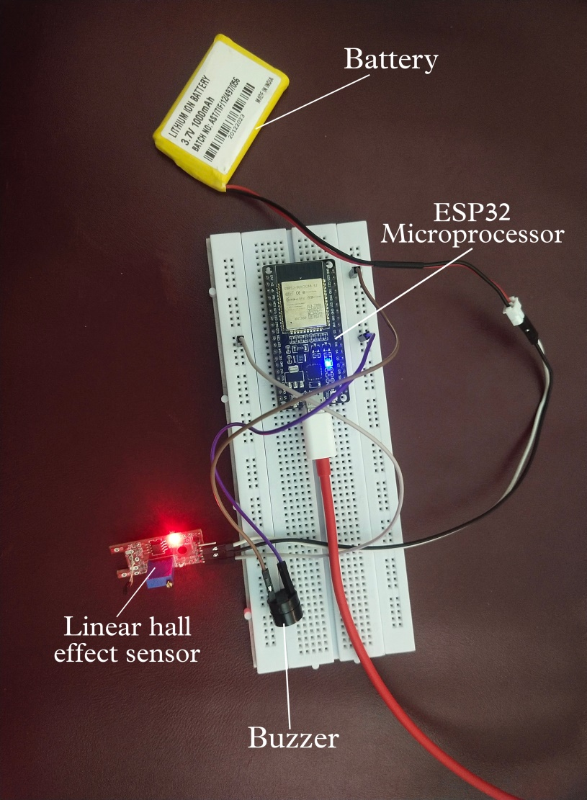
Proposed System
Precision in identifying radiation, specifically from sources like power generators.
Radiation level exceeds the thresholds, the device triggers both an audible alert through a buzzer and a notification to promptly inform the user.
Immediate alerts by recording and storing radiation level data for future analysis.
Notification system provides clear information on potential actions.
The device also features proactive measures for user safety in our technology-driven environment.
Architecture Diagram

Slide 9
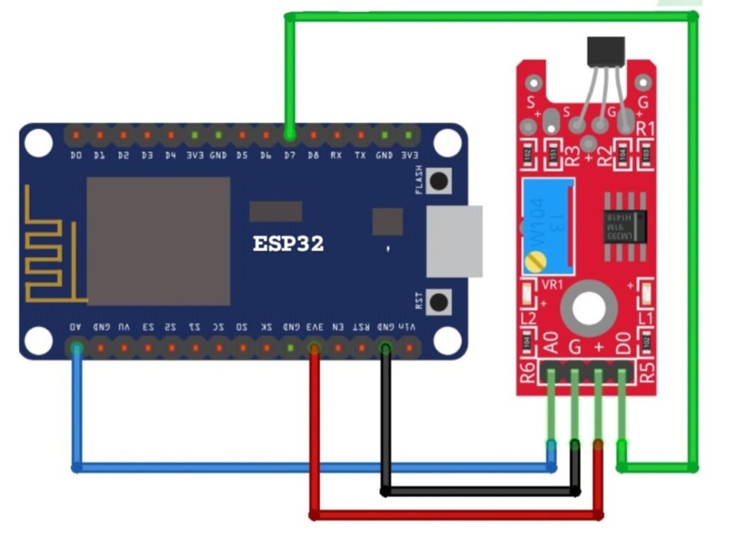
Software / Hardware used
Hardware:
ESP32 Microprocessor
Linear Hall Effect Sensor
Battery
Buzzer
Software:
Arduino IDE
Thingspeak
Twilio

Slide 10
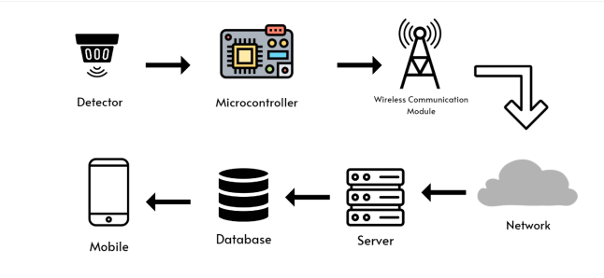
Architecture / Methodology used
The detection of electromagnetic radiation, swiftly processing and transmitting data to a centralized server.
Details stored in database, for future analysis.
Radiation exceeds thresholds, real-time mobile alerts are triggered, facilitating prompt responses.
The system's multi-layered communication enhances workplace safety.
Connecting individuals and database.
Addressing electromagnetic radiation challenges with a holistic approach.
This strategy empowers individuals with immediate information and enables well-coordinated responses to escalated radiation levels.
Ensuring comprehensive risk management.

Slide 11
System Implementation
Hardware Setup: Hall Effect sensor and ESP32 controller.
Software Development: Arduino C++, integrated necessary libraries for sensor interfacing and communication.
Sensor Calibration: Ensured accuracy of EMF readings through calibration techniques.
Data Processing: Extracted radiation levels from sensor.
Wireless Communication: Wi-Fi connectivity for transmitting data to ThingSpeak platform.
Threshold Monitoring: Defined thresholds for radiation levels, implemented logic for triggering Twilio notifications.
Integration with ThingSpeak and Twilio: Configured APIs for seamless data transmission and SMS alerts.
Testing and Validation: Conducted rigorous testing to validate system functionality and performance.

Slide 12
SDG GOALS
Goal 3: Good Health and Well-being
Goal 8: Decent Work and Economic Growth
Goal 9: Industry, Innovation, and Infrastructure
Goal 11: Sustainable Cities and Communities
Goal 12: Responsible Consumption and Production

Slide 13
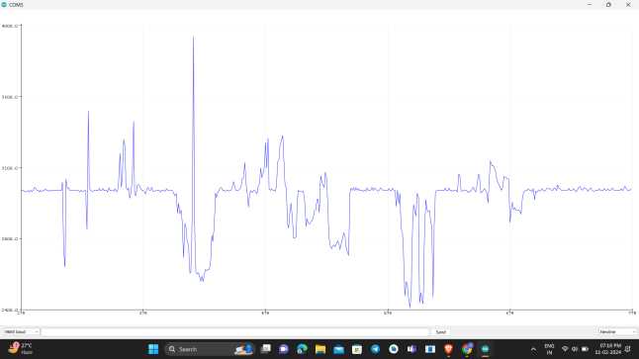
Result & Discussion
Result:
The proposed system, demonstrated effectiveness in evaluating general workplace safety and specific EMF radiation levels.
Real-time alerts and practical recommendations employees to prolonged EMF exposure.
Continuous monitoring pinpointed areas with elevated EMF levels.
Enhancing overall workplace safety.
Refining safety protocols in the context of EMF radiation exposure.

Slide 14
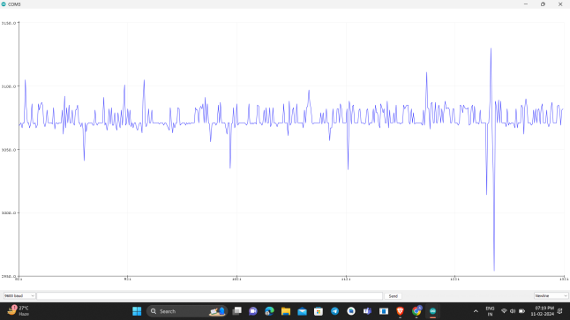
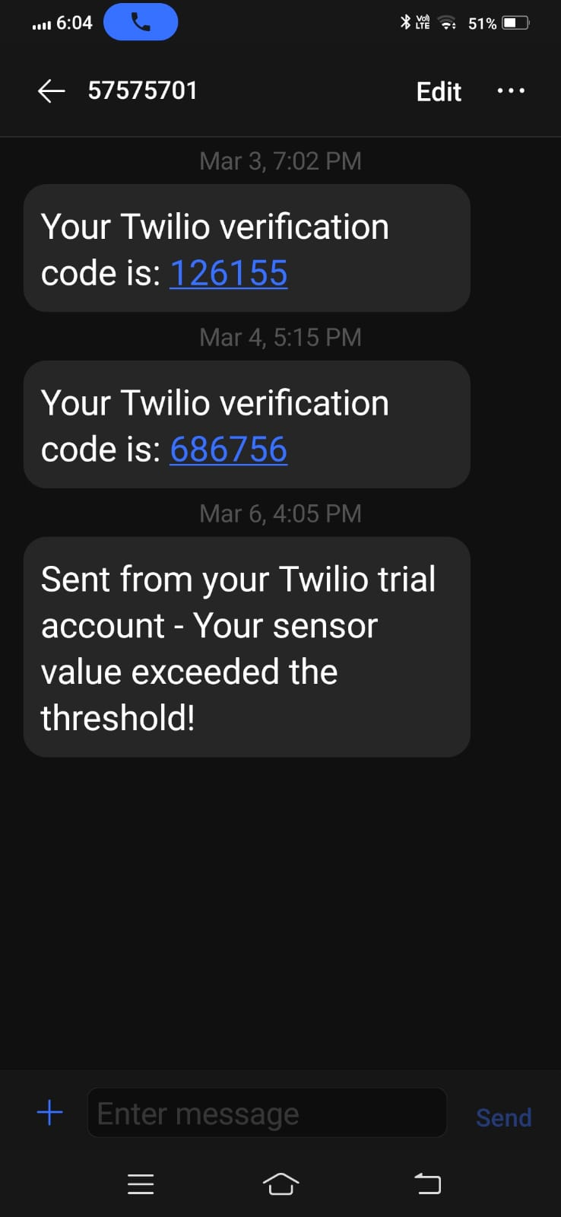
Result & Discussion
Discussion:
System marks a significant step in addressing EMF radiation concerns in workplaces.
Its real-time monitoring and protective recommendations provide a approach to managing EMF exposure and ensuring employee well-being.
Effectiveness is evident in its ability to identify specific areas of concern.
Optimizing overall workplace safety.
Precedent for comprehensive workplace safety.
Prioritizing employee.
Promoting public health and safety through
monitoring radiation exposure risks.

Slide 15
Reference Paper/ URL
1) A. Sharaf a,M. Zorkany , M. Shiple b High efficient low cost gamma-ray radiation sensor based on IoT platform Volume 15, Issue 4, December 2022, 100463 www.journals.elsevier.com/journal-of-radiation-research-and-applied-sciences
2) Muhammad Saifullah , Imran Sarwar Bajwa , Muhammad Ibrahim, and Mutyyba Asghar IoT-Enabled Intelligent System for the Radiation Monitoring and Warning Approach, Volume 2022, Article ID 2769958,https://doi.org/10.1155/2022/2769958.
3) Muhtadan , Adi Abimanyu , Rizqi Akmali , Mahrus Salam , Design of IoT-based Radiation Monitor Area for Nuclear and Radiological Emergency Preparedness System in Yogyakarta Nuclear Area, 1428 (2020) 012050, doi:10.1088/1742-6596/1428/1/012050.
4) F. Torres-Hoyos, R. Baena-Navarro, J. Vergara-Villadiego & A. Pérez Gómez, Design and assembly of an IOT based device to determine Absorbed dose of gamma and UV radiation in skin, ISSSD 2019, Volume 1.
5) Hiroshi Yasuda * , Chryzel Angelica B. Gonzales, Soheil Aghabaklooei, Radiation Measurements, Volume 166, August 2023, 106964, www.elsevier.com/locate/radmeas.
6) Nida Tabassum Khan, Radioactivity: Detection and Measurement, Volume 7 • Issue 2 • 1000135, DOI: 10.4172/2155-9937.1000135.

Slide 16
Reference Paper/ URL
7) F.N. Flakus, Detecting and measuring ionizing radiation, IAEA BULLETIN, VOL 23,No4,https://www.iaea.org/sites/default/files/publications/magazines/bulletin/bull23- 4/23405043136.pdf.
8) Liudmila Liutsko, Deborah Oughton, Yevgeniya Tomkiv , Paola Fattibene , Sara Della Monaca , Cristina Nuccetelli , Aya , Takashi Ohba , Yuliya Lyamzina, Koichi Tanigawa , Natallia Novikava, Vadim Chumak, Philippe Pirard, Sylvie Charron, Dominique Laurier, Pascal Croüail , Thierry Schneider, Joan Francesc Barquinero, Adelaida Sarukhan and Elisabeth Cardis, (SHAMISEN SINGS project), : Liudmila Liutsko et al 2023 J. Radiol. Prot. 43 041511, https://iopscience.iop.org/article/10.1088/1361-6498/ad115a/pdf.
9) Yabo Fu, Hao Zhang, Eric D. Morris, Carri K. Glide-Hurst, Suraj Pai , Alberto Traverso, Leonard Wee , Ibrahim Hadzic , Per-Ivar Lønne , Chenyang Shen , Tian Liu, and Xiaofeng Yang, Artificial Intelligence in Radiation Therapy ,VOL. 6, NO. 2, FEBRUARY 2022, https://ieeexplore.ieee.org/stamp/stamp.jsp?tp=&arnumber=9521554
10) B. Blake Levitt, Henry C. Lai and Albert M. Manville II ,Low-level EMF e ects on wildlife and plants,25 November 2022, Vol 10, ISSN=2296-2565

Slide 17
Reference Paper/ URL
11) Devra Davis, Linda Birnbaum, Paul Ben-Ishai, Hugh Taylor, Meg Sears, Tom Butler, Theodora Scarato, Wireless technologies, non-ionizing electromagnetic fields and children: Identifying and reducing health risks, Current Problems in Pediatric and Adolescent Health Care, Volume 53, Issue 2, 2023, 101374, ISSN 1538-5442, https://doi.org/10.1016/j.cppeds.2023.101374
12) Chen, H.; Liu, Q.; Li, Y.; Huang, C.; Zhang, H.; Xu, Y. Research on the Method of Near-Field Measurement and Modeling of Powerful Electromagnetic Equipment Radiation Based on Field Distribution Characteristics. Energies 2023, 16, 2005. https://doi.org/10.3390/en16042005
13) Agbakhamen Eco, Prof. Okeke Gerald Ndubuisi. Biological hazard of electromagnetic radiation: A Comprehensive analysis using mobile phones as a case study, Vol. 2 No. 01 (2024): IPHO-Journal of Advance Research in Science And Engineering.
14) Kaur, P.; Rai, U.; Singh, R. Genotoxic Risks to Male Reproductive Health from Radiofrequency Radiation. Cells 2023, 12, 594. https://doi.org/10.3390/cells12040594
15) Leszczynski, Dariusz. "The lack of international and national health policies to protect persons with self-declared electromagnetic hypersensitivity" Reviews on Environmental Health, 2022. https://doi.org/10.1515/reveh-2022-0108

Slide 18
Reference Paper/ URL
16) M. Kai, T. Homma, J. Lochard, T. Schneider, J.F. Lecomte, A. Nisbet, S. Shinkarev, V. Averin, T. Lazo; CRP, 2020. Radiological protection of people and the environment in the event of a large nuclear accident: update of ICRP Publications 109 and 111. ICRP Publication 146.Ann. ICRP 49(4).
17) María Ángeles Ontalba, José Ángel Corbacho, Antonio Baeza, José Vasco, José Manuel Caballero, David Valencia, Juan Antonio Baeza, Radiological Alert Network of Extremadura (RAREx) at 2021:30 years of development and current performance of real-time monitoring, Nuclear Engineering and Technology, Volume 54, Issue 2, 2022, Pages 770-780, ISSN 1738-5733, https://doi.org/10.1016/j.net.2021.08.007.
18) Arpit Patel et al,A review on Radiation Detectors for Various Radiation Detection Applications, 2023,J. Rad. Nucl.Appl.8, No. 2, 93-111 / http://www.naturalspublishing.com/Journals.asp.
19) Ahmad, M.I.; Ab. Rahim, M.H.; Nordin, R.; Mohamed, F.; Abu-Samah, A.; Abdullah, N.F. Ionizing Radiation Monitoring Technology at the Verge of Internet of Things. Sensors 2021, 21, 7629. https://doi.org/10.3390/s21227629

